Slide 1
July 11 Measurements
Pulsedwire measurements for centering wire.

Slide 2
Why still taking measurements?
Lasers are now collimated, wire is as close to slit as possible. Previously I had been moving wire away from slit to reduce sensitivity and “increase” linear region. This was incorrect…
Python analysis gives more accurate measurements (average 30 shots) and without a reference magnet we can stay nearer to the good linear region.
Reference magnet probably did more harm than good, especially since we were not scanning the derivative of the linear region.
Measure calibration of laser before-hand to ensure we are at best position. Always move laser to be at that signal when taking measurements.

Slide 3
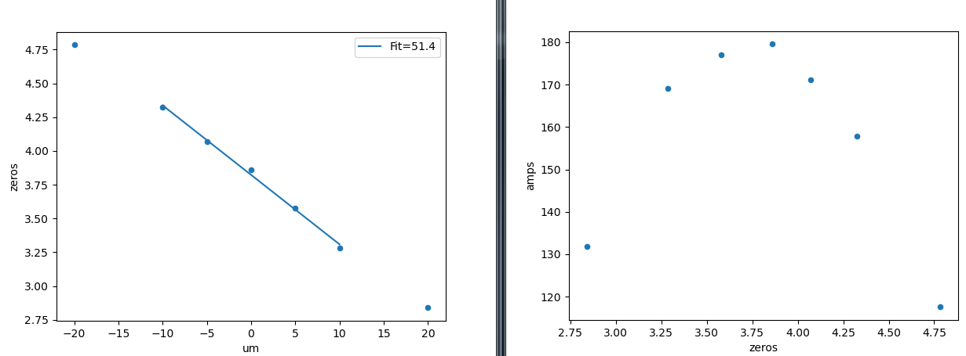
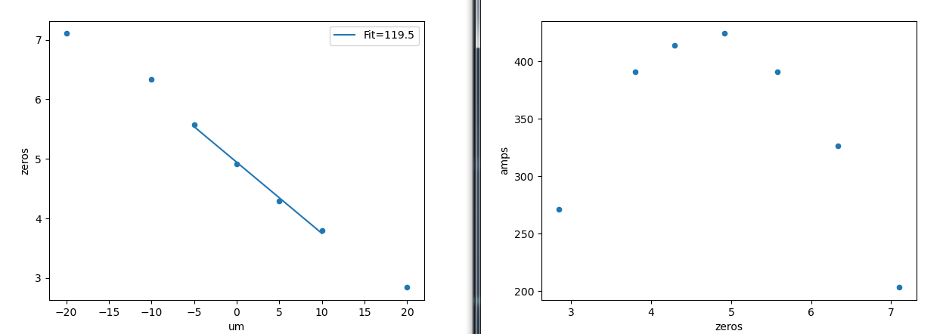
Calibrations
Xtrajectory:
Ytrajectory:

Slide 4
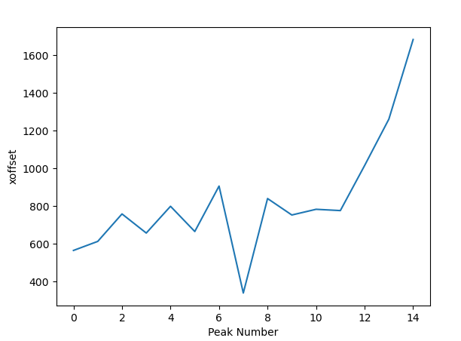
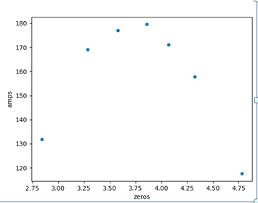
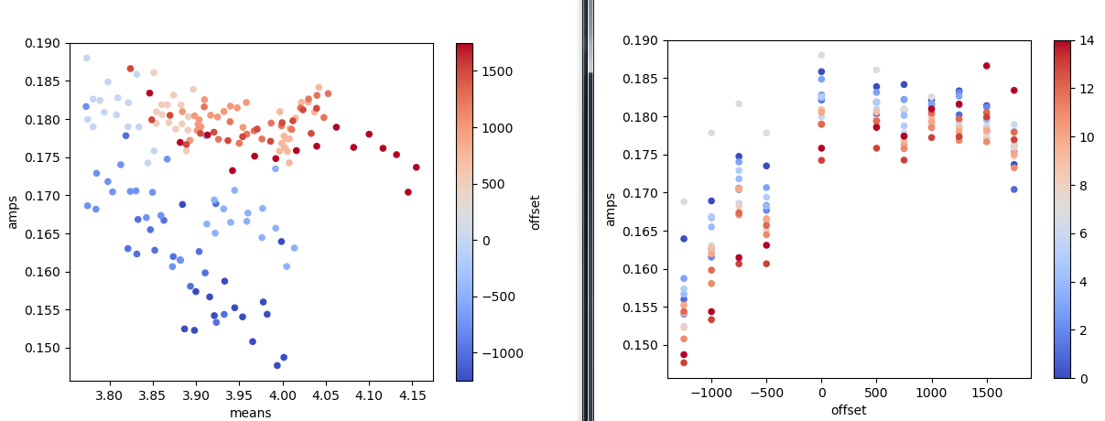
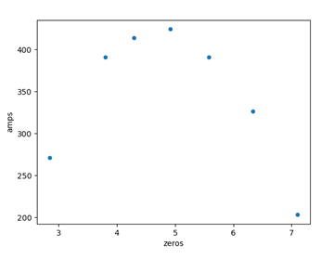
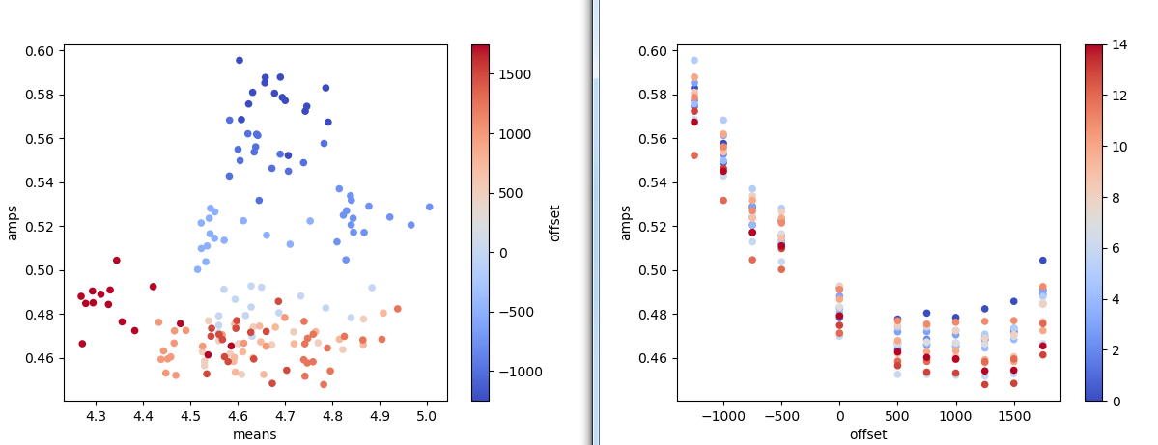
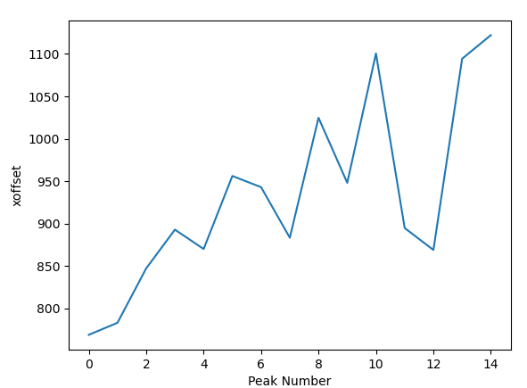
Xoffset
Not sure if posts got displaced
Wire is visibly uncentered in x
Top: Xtraj, Bottom:Ytraj

Slide 5
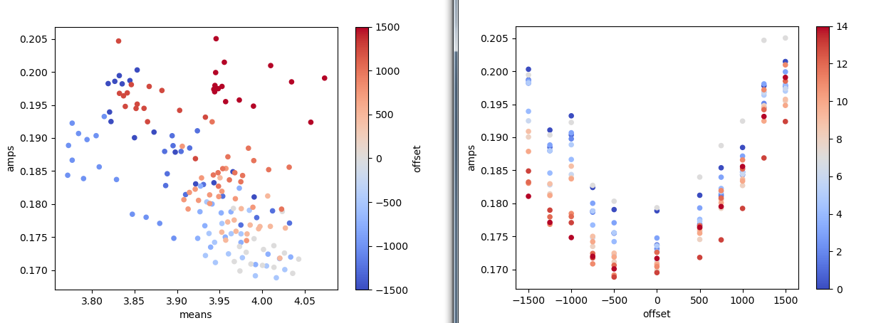
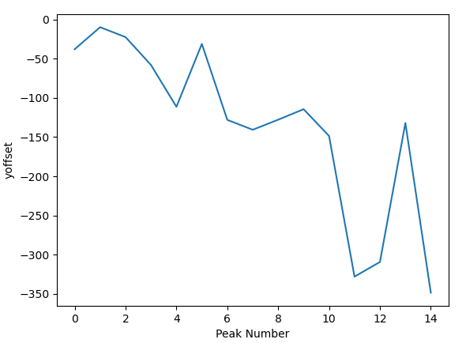
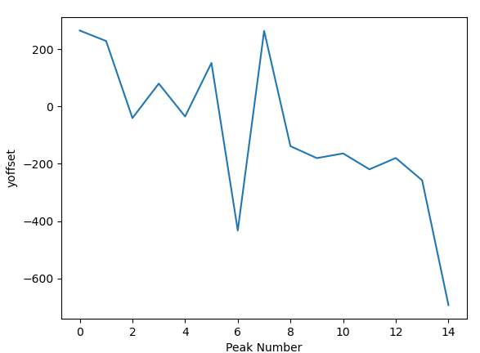
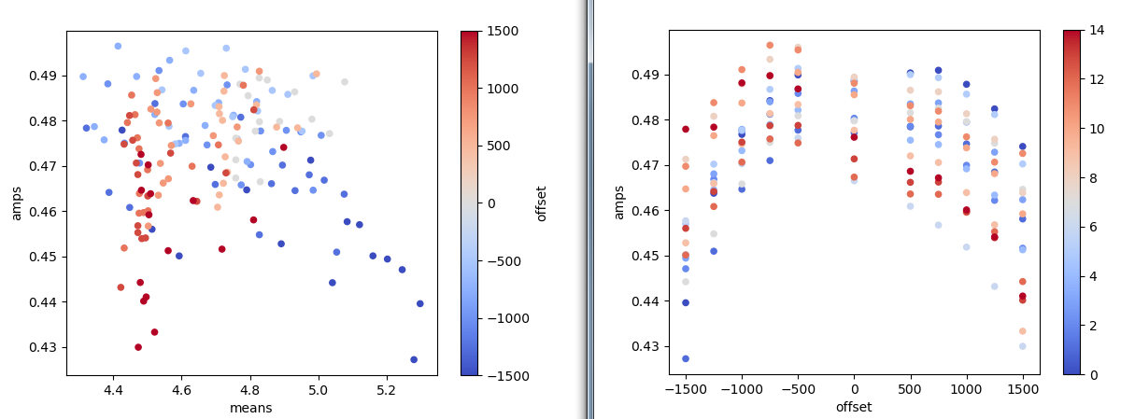
Yoffset
Top: Xtraj, Bottom:Ytraj

Slide 6
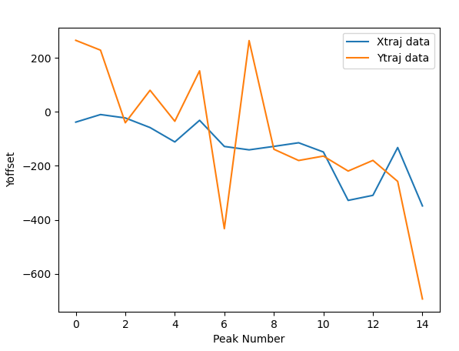
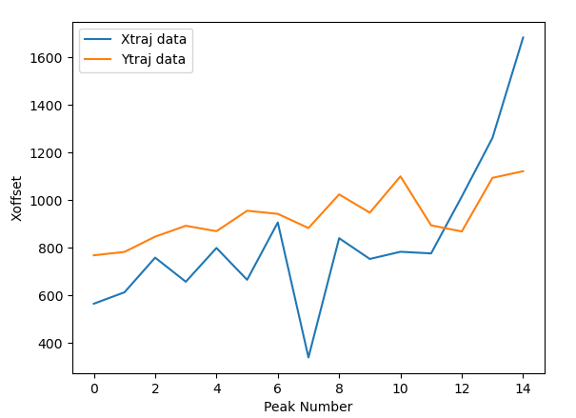
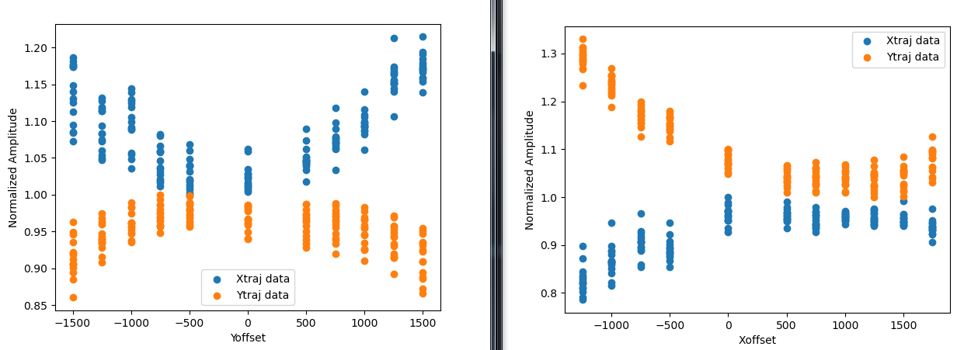
Putting on same plots…
Pretty similar trends…
Lets move the wire and see if consistent results continue…
Eyeball axis of Xoffset to be line through (0, 600), (14, 800)
Eyeball axis of Yoffset to be line through (0,0), (14, -200)

Slide 7
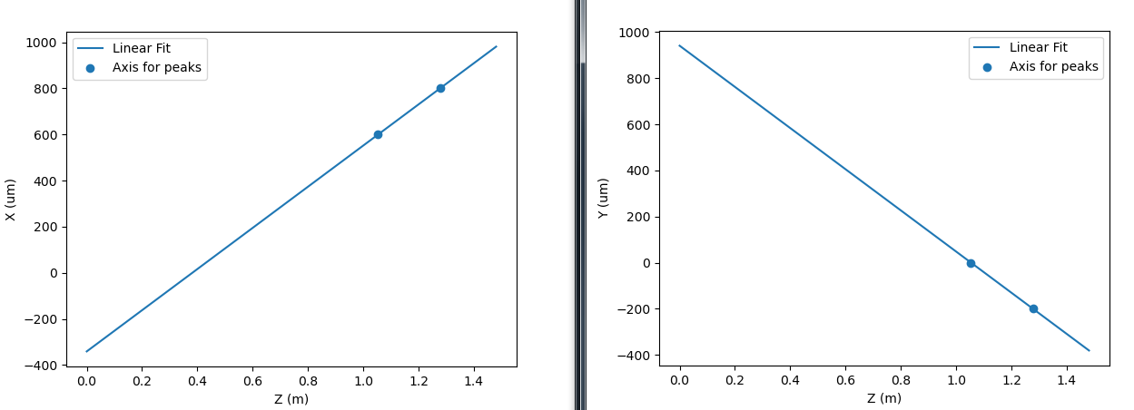
Moving Wire (July 12, 11AM)
Previous position:
P1 = (5.00, 11.55) mm
P2 = (4.97, 10.75) mm
For line fits described on previous page, we need to move:
dP1 = (-.340, .940)
dP2 = (.980,-.380)
New exact positions:
P1 = (4.66, 12.49)
P2 = (5.95, 10.37)
To make easier on adjustments, I round to nearest 50um
New positions:
P1 = (4.65, 12.50)
P2 = (5.95, 10.35)

Slide 8
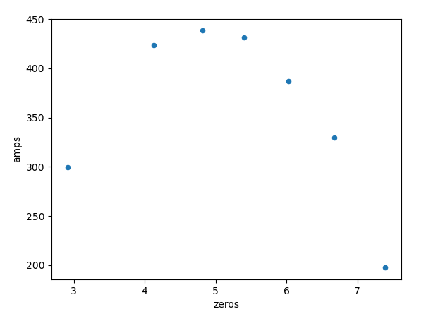
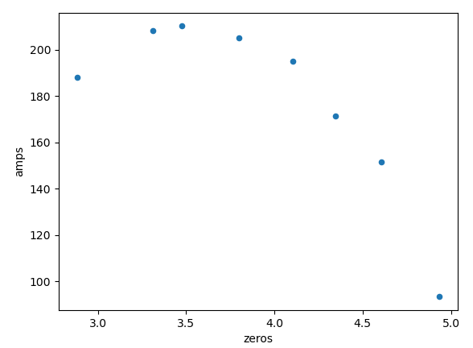
July 12 Measurements
Xcalibration on left, Ycalibration on right

Slide 9
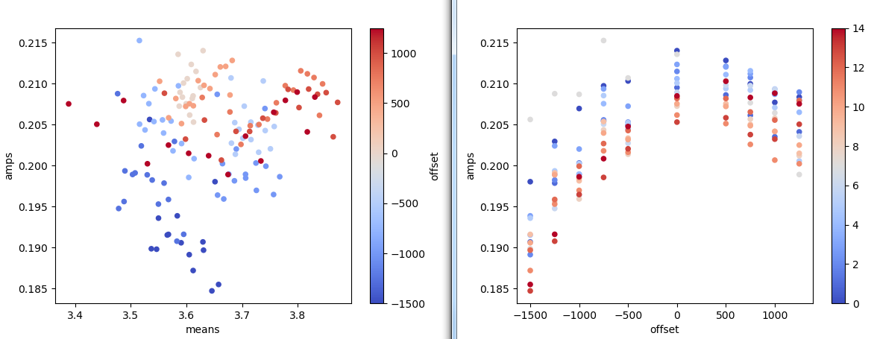
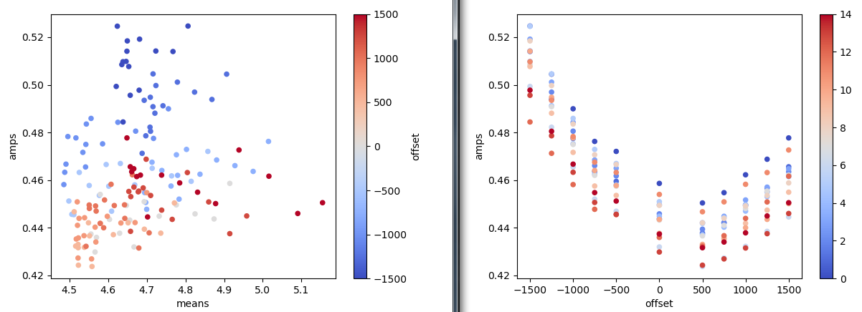
Xoffset
text

Slide 10
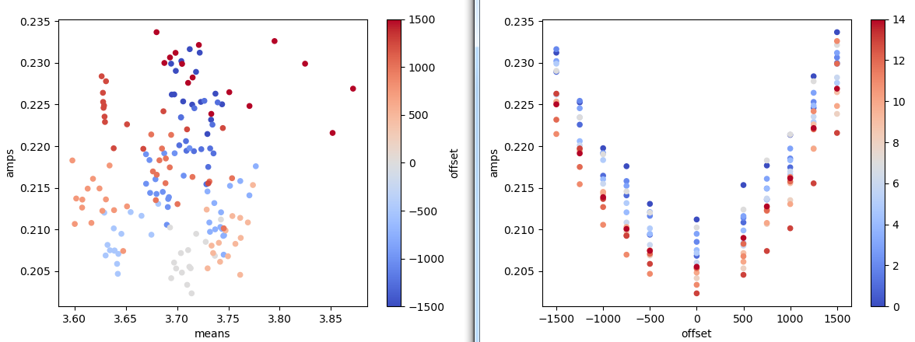
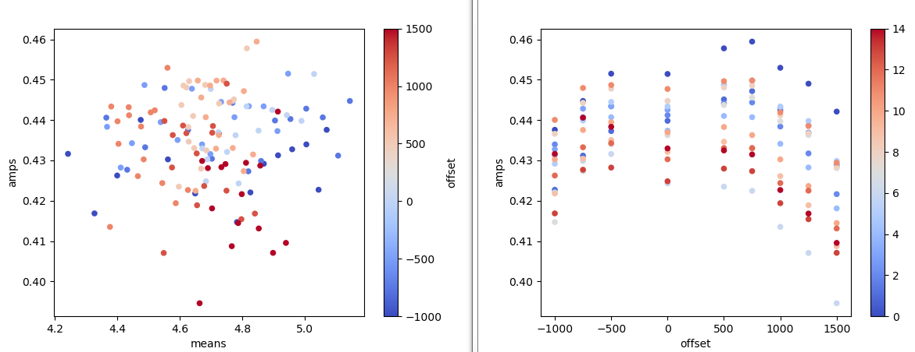
Yoffset
text

Slide 11
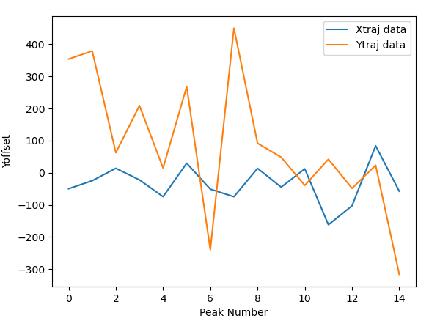
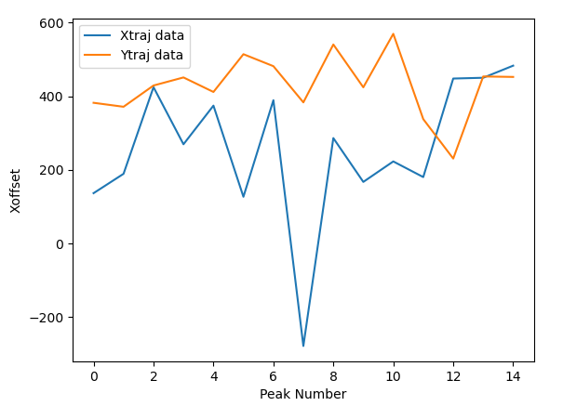
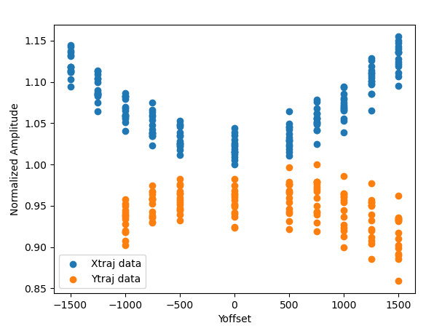
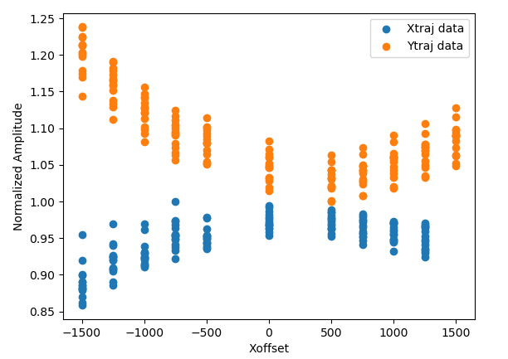
Putting on same plots (July 12)
text

Slide 12
Reminder where we were before adjustment (July 11)
Pretty similar trends…
Lets move the wire and see if consistent results continue…
Eyeball axis of Xoffset to be line through (0, 600), (14, 800)
Eyeball axis of Yoffset to be line through (0,0), (14, -200)

Slide 13
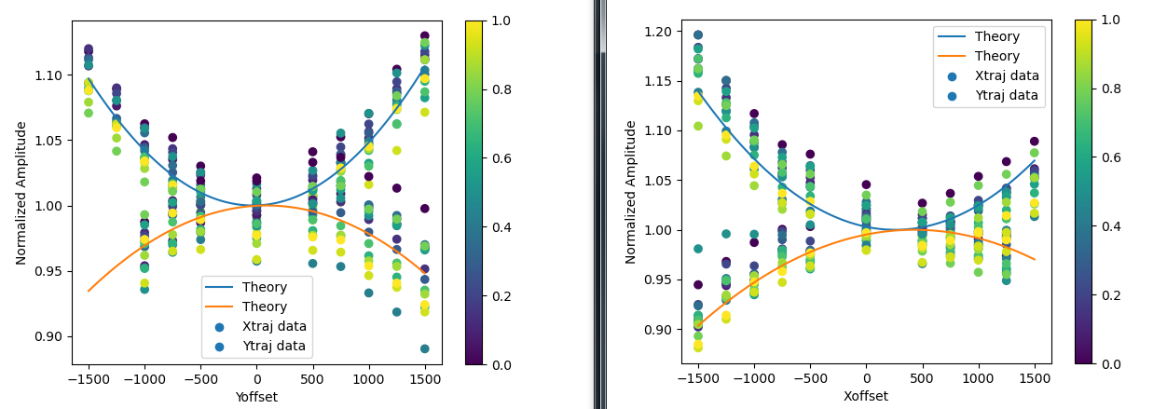
If you wanted theory lines

Slide 14
Moving Wire (July 13, 1PM)
Previous position:
P1 = (4.65, 12.50)
P2 = (5.95, 10.35)
Want to move +400um in x direction.
New positions:
P1 = (5.05, 12.50)
P2 = (6.35, 10.35)

Slide 15
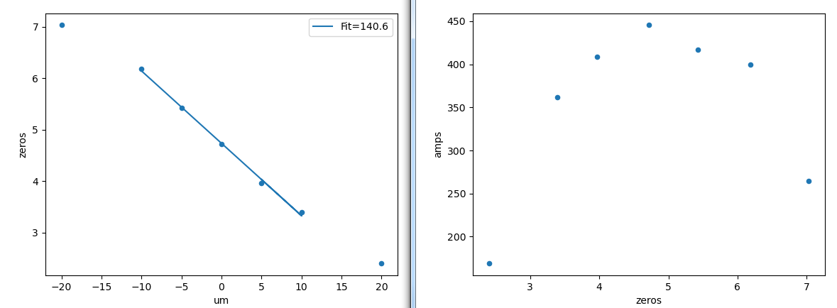
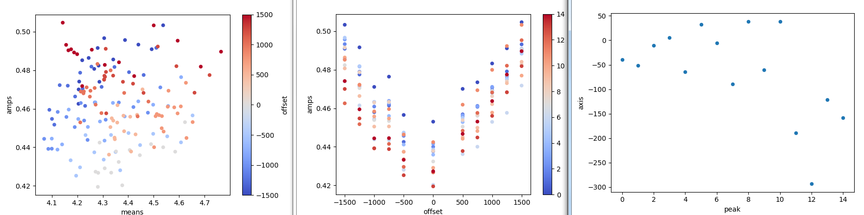
Check if ytraj,xoffset moved correctly
Calibration
Wirescan data

